Slide 1

COMM223 Marketing Management
Lecture 8 – Pricing

Slide 2
Agenda
Pricing
What is price
Major pricing strategies
Factors influencing price decision
Internal factors
External factors
New product pricing
Product mix pricing
Framing

Slide 3
Where are we now …
Company
Company Analysis
Competitor Analysis
Consumer Analysis
Marketing Management
Competitor
Consumer
Product
Promotion
Price
Distribution
Product - Market

Slide 4
What Is a Price?
Price: the amount of money charged for a product or service, or the sum of values exchanged for the benefits of having or using the product or service
Price is the only marketing mix element that produces revenue
Pricing best practices:
Develop a 1% pricing mindset
Consistently deliver more value
Price strategically, not opportunistically
Know your competition
Make pricing a process
Source: Paul Hunt, Strategic Pricing Division, The Advantage Group, Toronto, Ontario

Slide 5
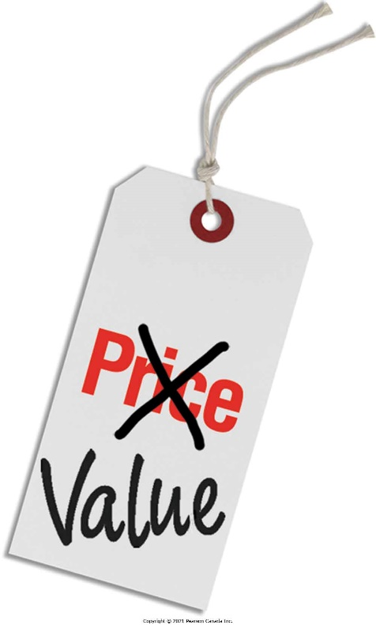
Pricing: An Important but Difficult Decision
Price and the Marketing Mix
Only element to produce revenues
Most flexible element
Can be changed quickly
Common Pricing Mistakes
Reducing prices too quickly
to get sales
Pricing based on costs,
not customer value

Slide 6
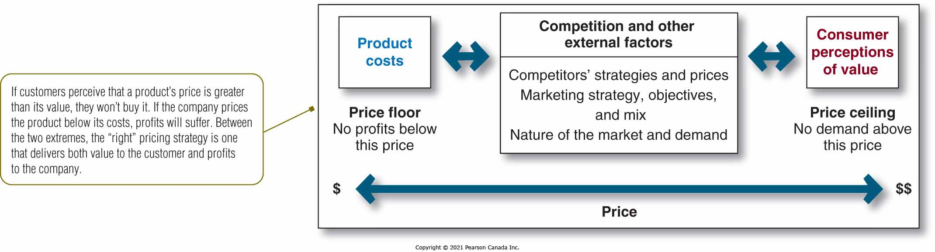
Major Considerations in Setting Price

Slide 7
Pricing Strategy: Cost-Based Pricing
Based on the costs of producing, distributing, and selling the product plus a fair rate of return for effort and risk
Types of costs:
Fixed costs (overhead)
Variable costs
Total costs

Slide 8
Pricing Strategy: Cost-Based Pricing
Cost-plus pricing: adding a standard markup to the cost of the product
Simplest pricing method:
Figure out the unit cost
Add a standard markup
Unit cost
price = ----------------------
(1- desired return)
Pros
Cons

Slide 9
Pricing Strategy: Cost-Based Pricing
Cost-Plus Pricing Example
- Variable costs: $20 - Fixed costs: $ 500,000
- Expected sales: 100,000 units - Desired Sales Markup: 20%
Variable Cost + Fixed Costs/Unit Sales = Unit Cost
$20 + $500,000/100,000 = $25 per unit
Unit Cost/(1 – Desired Return on Sales) = Markup Price
$25 / (1 - .20) = $31.25

Slide 10
Pricing Strategy: Cost-Based Pricing
Break-even pricing (target return pricing)
Setting price to break even on the costs of making and marketing a product, or setting price to make a target return
盈亏平衡定价法也叫保本定价法或收支平衡定价法是指在销量既定的条件下，企业产品的价格必须达到一定的水平才能做到盈亏平衡、收支相抵。

Slide 11
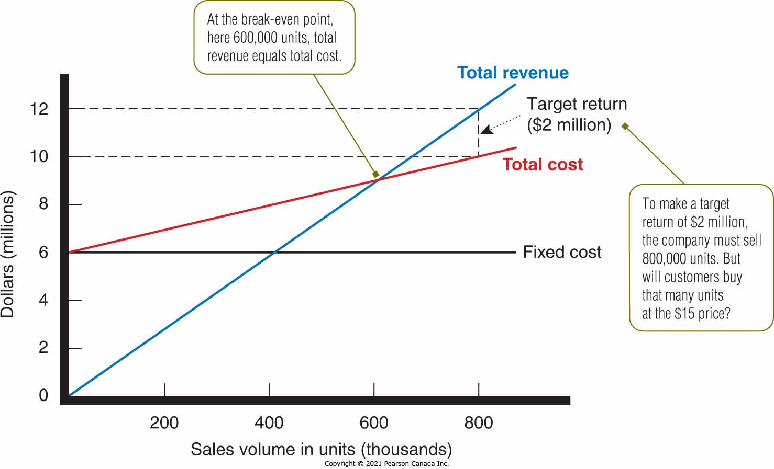
Break-even and Target Return Pricing
Used primarily when judging feasibility of a market action.
Sensitivity analysis

Slide 12
Pricing Strategy: Customer Value-Based Pricing
Based on buyers’ perceptions of value rather than on the seller’s cost
Price is considered before the marketing program is set.
Measuring perceived value can be difficult.

Slide 13
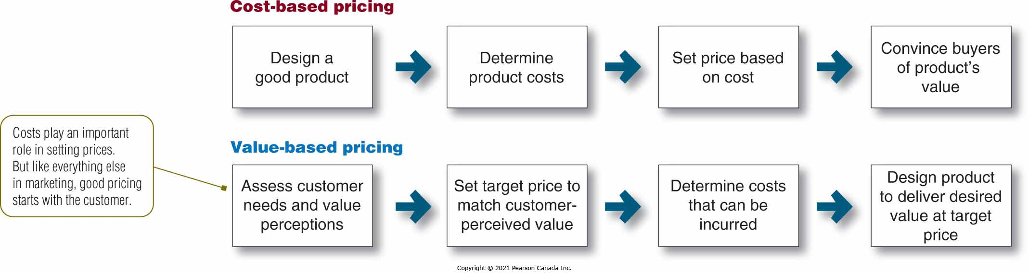
Cost-Based versus Value-Based Pricing

Slide 14
Pricing Strategy: Customer Value-Based Pricing
Two types of value-based pricing
Good-value pricing
Offering just the right combination of quality and good service at a fair price
Everyday low pricing (EDLP) vs. high-low pricing
Value-added pricing
Attaching value-added features and services to differentiate a company’s offers and charging higher prices

Slide 15
Pricing Strategy: Competition-Based Pricing
Competition-based pricing:
Setting prices based on competitors’ strategies, costs, prices, and market offerings
Company should ask several questions to assess competitors’ pricing strategies:
How does the company’s market offering compare with competitors’ offerings in terms of customer value?
How strong are current competitors?
What are their current pricing strategies?

Slide 16
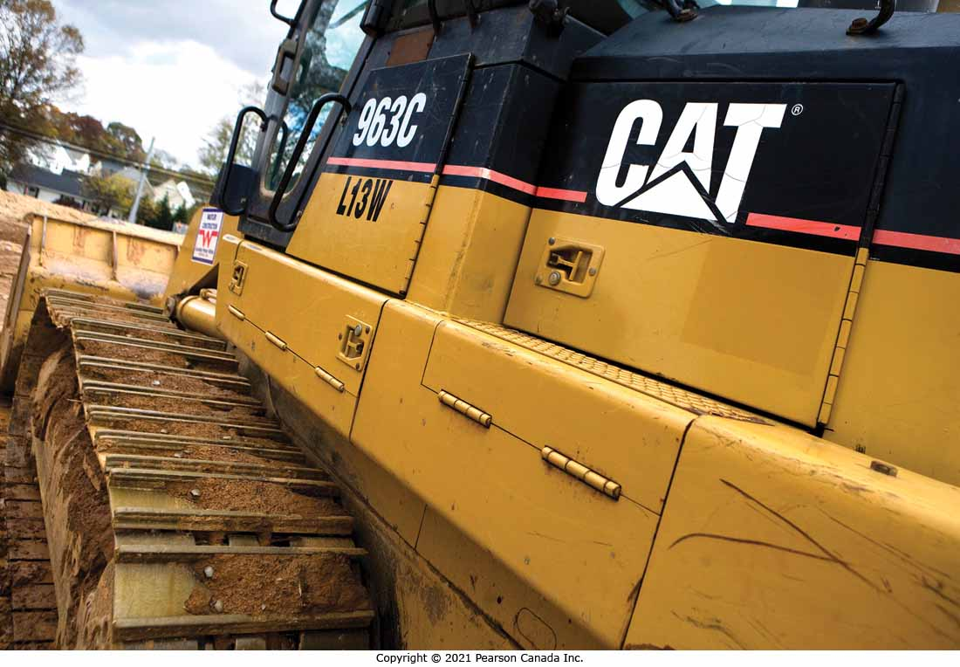
Competition-Based Pricing
Caterpillar dominates the heavy equipment industry despite charging premium prices.
$420 000 | the Caterpillar’s price if equivalent to the competitor’s bulldozer
$50 000 | the value added by Caterpillar’s superior reliability and durability
$40 000 | the value added by Caterpillar’s lower lifetime operating costs
$40 000 | the value added by Caterpillar’s superior service
$20 000 | the value added by Caterpillar’s longer parts warranty
$570 000 | the value-added price for Caterpillar’s bulldozer
−$70 000 | discount
$500 000 | final price

Slide 17
Factors Affecting Pricing Decisions
Internal factors
Overall marketing strategy, objectives, and mix
Organizational considerations
External factors
Market and demand
Economy
Impact on other parties in its environment

Slide 18
Factors to Consider When Setting Price
Internal Factors
Marketing strategies, objectives, and mix
Organizational considerations
Market positioning influences pricing strategy
Other pricing objectives:
Survival
Current profit maximization
Market share leadership
Product quality leadership

Slide 19
Factors to Consider When Setting Price
Internal Factors
Marketing strategies, objectives, and mix
Organizational considerations
Pricing must be carefully coordinated with the other marketing mix elements
Positioning may be based on price.
Target costing starts with an ideal selling price, then targets costs that ensure the price is met.
Nonprice positions can be created to differentiate the marketing offer.

Slide 20
Factors to Consider When Setting Price
Internal Factors
Marketing strategies, objectives, and mix
Organizational considerations
Management decides who should set prices.
Varies depending on the size and type of company
Small companies—Top management
Large companies—Divisional or product managers
Industries with price as the key factor—Pricing departments

Slide 21
Factors to Consider When Setting Price
External Factors
Nature of market and demand
Economy
Other environmental elements
Types of markets
Pure competition
Monopolistic competition
Oligopolistic competition
Pure monopoly
Price-demand relationship
Demand curve
Price elasticity of demand

Slide 22
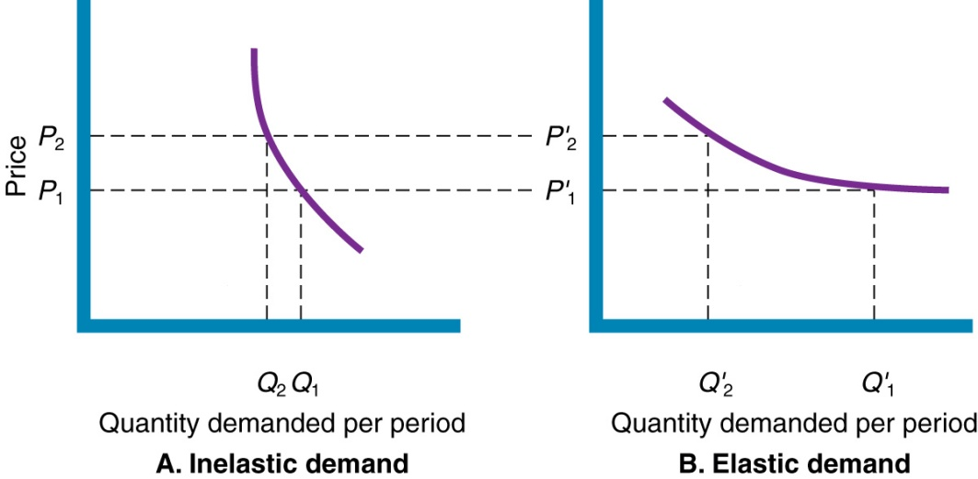
The Price-Demand Relationship
Demand curve: a curve that shows the number of units the market will buy at different possible prices in a given time period
Price elasticity of demand:
Calculated as the % change in quantity demanded divided by the % change in price; values >1 elastic and <1 are inelastic
Availability of product substitutes will influence elasticity
Elastic products: lower price to maximize revenue
Inelastic products:必需品，通常没有替代品 raise price to maximize revenue
Prestige goods behave in a contrary fashion due to consumer perception of value

Slide 23
Factors to Consider When Setting Price
External Factors
Nature of market and demand
Economy
Other environmental elements
Factors impacting pricing strategies
Boom or recession
Inflation
Interest rates
Responses to the frugality of post recession consumers
Cut prices and offer discounts
Develop more affordable items
Redefine value propositions

Slide 24
Factors to Consider When Setting Price
External Factors
Nature of market and demand
Economy
Other environmental elements
Reseller reactions to prices must be considered
Government may restrict or limit pricing options
Social considerations may be taken into account

Slide 25
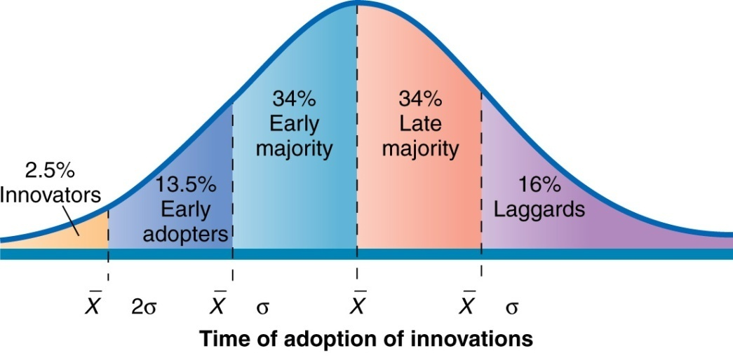
New Product Pricing: Market-Skimming Pricing
Setting a high price to skim maximum revenues layer by layer from segments willing to pay the high price, the company makes fewer but more profitable sales (e.g., digital camera, Sony HDTV)
Favorable conditions:
Skimming price drops in steps

Slide 26
New Product Pricing: Market-Penetration Pricing
Setting a low price to attract a large number of buyers and a large market share
Favorable conditions:
However, the low price
Usually sacrifices profitability
May ignite a price war

Slide 27
Product Mix Pricing Strategies
Pricing Situation | Description
Product line pricing | Setting prices across an entire product line
Optional-product pricing | Pricing optional or accessory products sold with the main product
Captive-product pricing | Pricing products that must be used with the main product
By-product pricing | Pricing low-value by-products to get rid of or make money on them
Product bundle pricing | Pricing bundles of products sold together

Slide 28
Bundling
Bundle
The marketing of two or more products for a single package price.
Ex.
McDonald’s “Value Meal”
Lower car wash price if you buy gas

Slide 29
Discussion Question
Why Bundle?

Slide 30
(Based on Kahneman &Tversky 1979)
Framing

Slide 31
Some Phenomena
A store lists 10% off outside the store. Inside the store, it offers another 10% off on the price tag. Why doesn’t it just list as 20% off directly?
Why people spend more with credit card than with cash?
Why people usually prefer a monthly plan to one with pay per minute, even when they will be much better off by choosing the second plan?

Slide 32
Read Chapter 10

